Slide 1
CS 422 - Group 4
Medication Manager
Luqmaan Baiyat, KT Mancillas, Keval Patel, Jose E. Rodriguez,
Mohammed Shafiuddin

Slide 2
Problem Space - Opioid Addiction
According to the National Institute on Drug Abuse:
“Roughly 21 to 29 percent of patients prescribed opioids for chronic pain misuse them.”
“Between 8 and 12 percent develop an opioid use disorder.”
“An estimated 4 to 6 percent who misuse prescription opioids transition to heroin.”
“About 80 percent of people who use heroin first misused prescription opioids.”
Our goal is to help patients keep better track their medication usage and also remind them when it’s the right time to take them.

Slide 3
Example Tasks
Add a new medication labeled Vicodin to be taken once every 2 hours from 12:00 pm to 8:00 pm, repeated for 7 days.
Edit the medication labeled Fentanyl by changing the start time from 10:00 am to 11:00 am, and the end time from 7:00 pm to 8:00 pm.
View all medications taken on April 17th, 2019.

Slide 4
Computer Prototype - First Iteration
For the first iteration, we focused on getting the basic functionality of the interface working, with less emphasis on how data was stored and transferred from different parts of the interface.
For this reason, we used predefined values and data for displayed information, but allowed the users to use the input fields as they would need to.

Slide 5
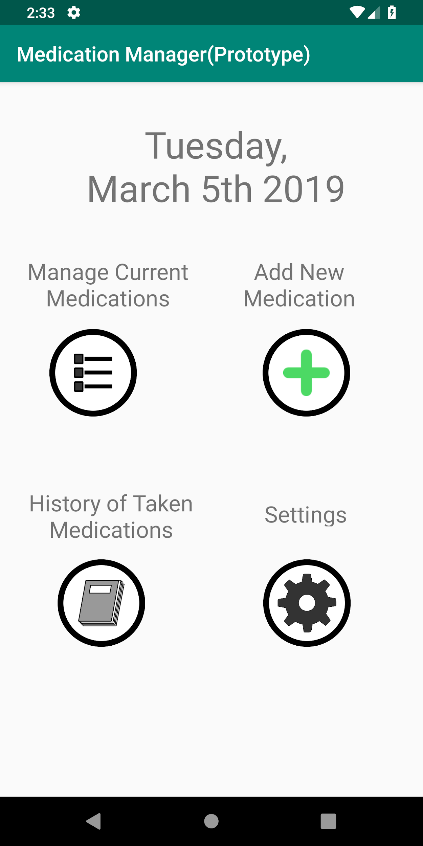
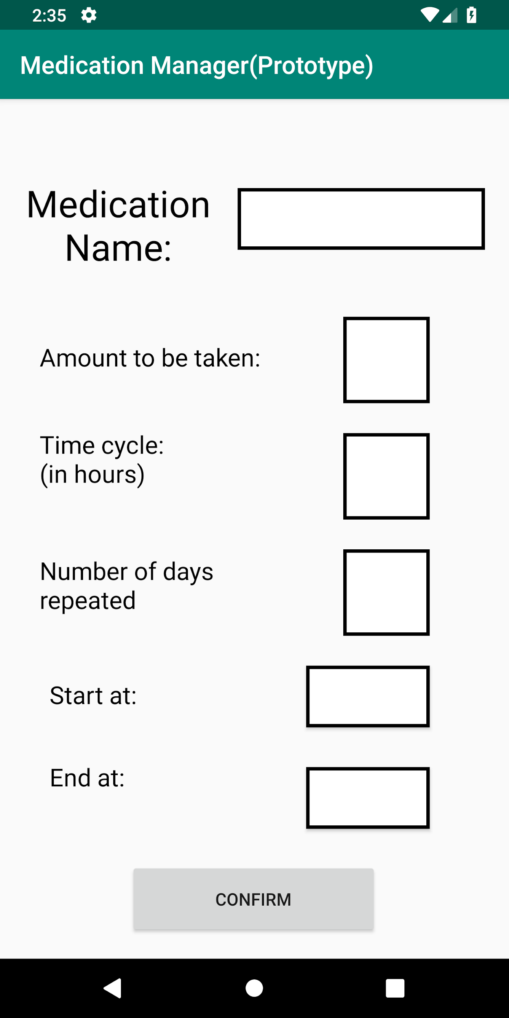
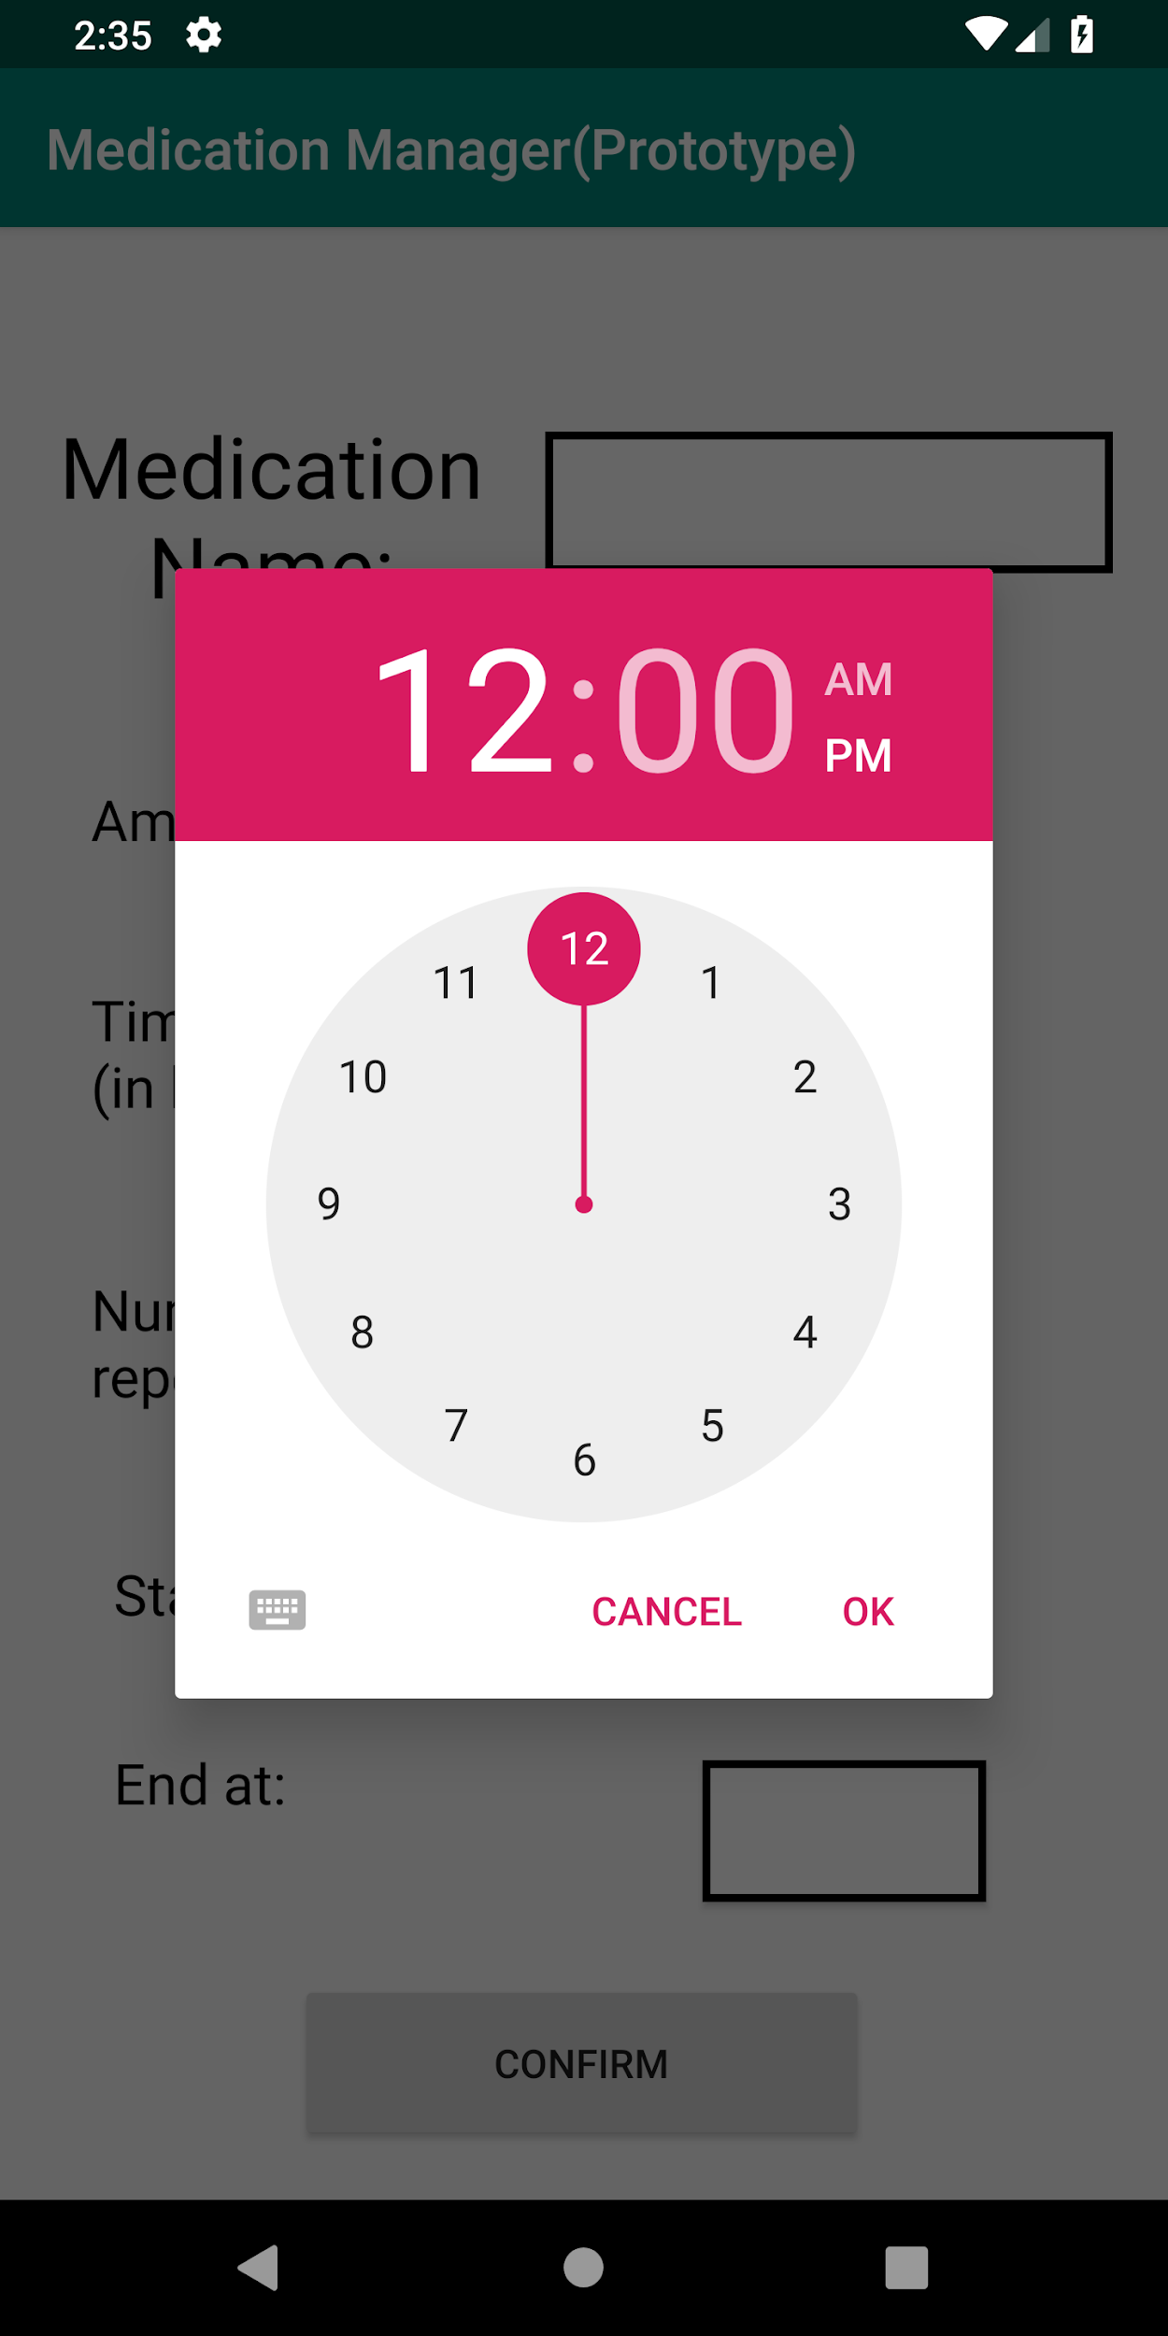
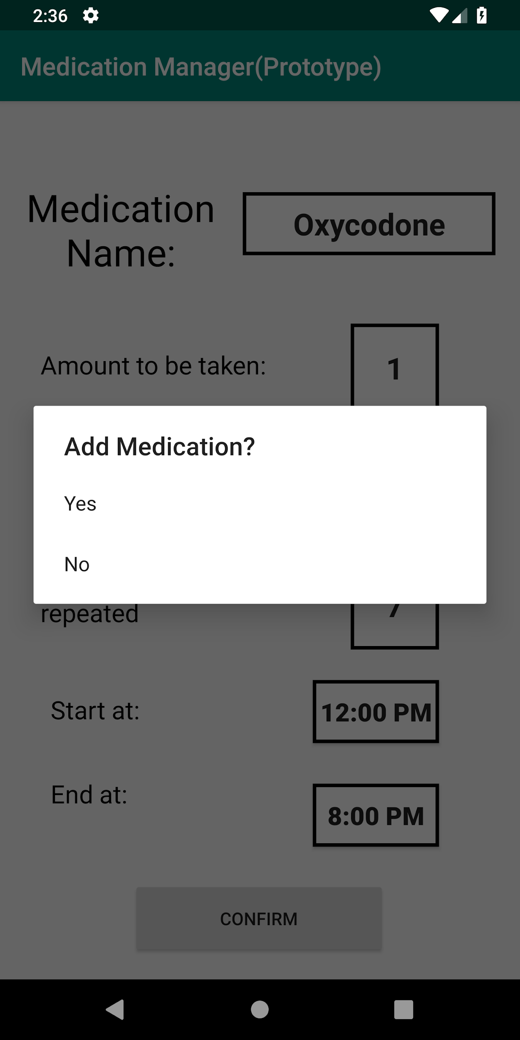
Computer Prototype - First Iteration
Adding a new medication
Application
Home Screen
Adding Medication Screen
Time Picker
Dialog for Time Inputs
Confirmation
Popup

Slide 6
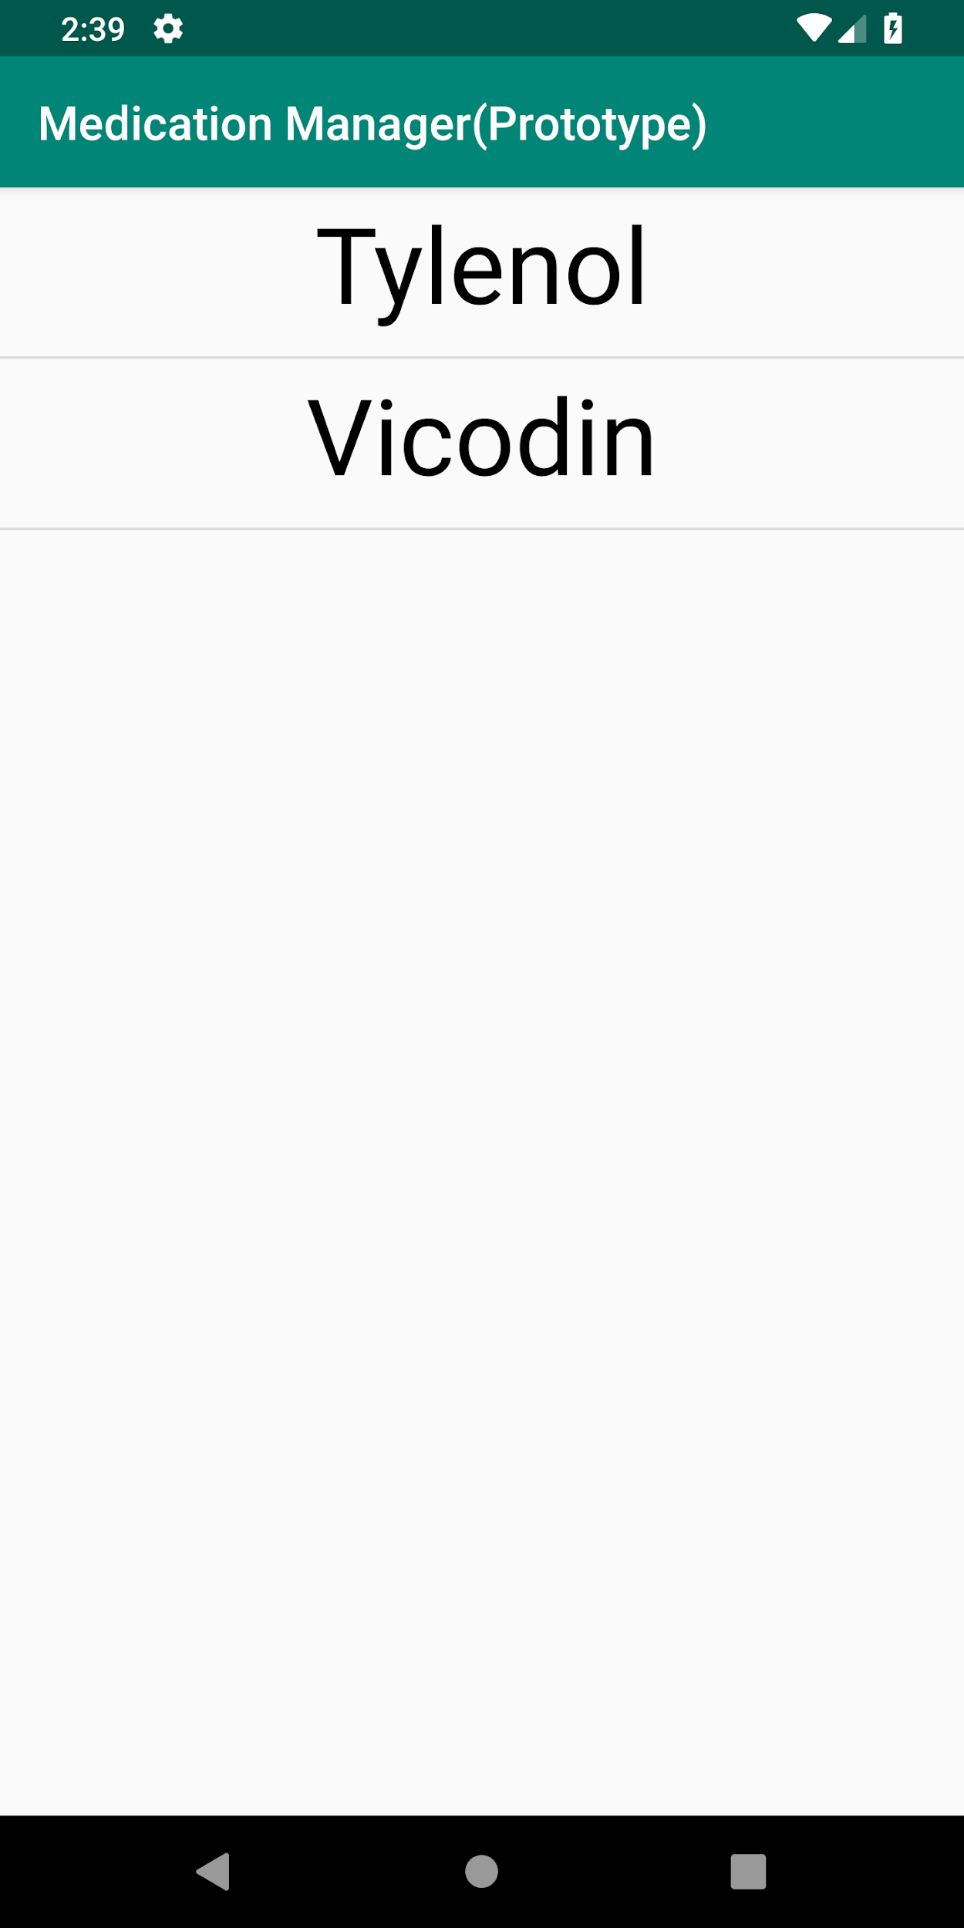
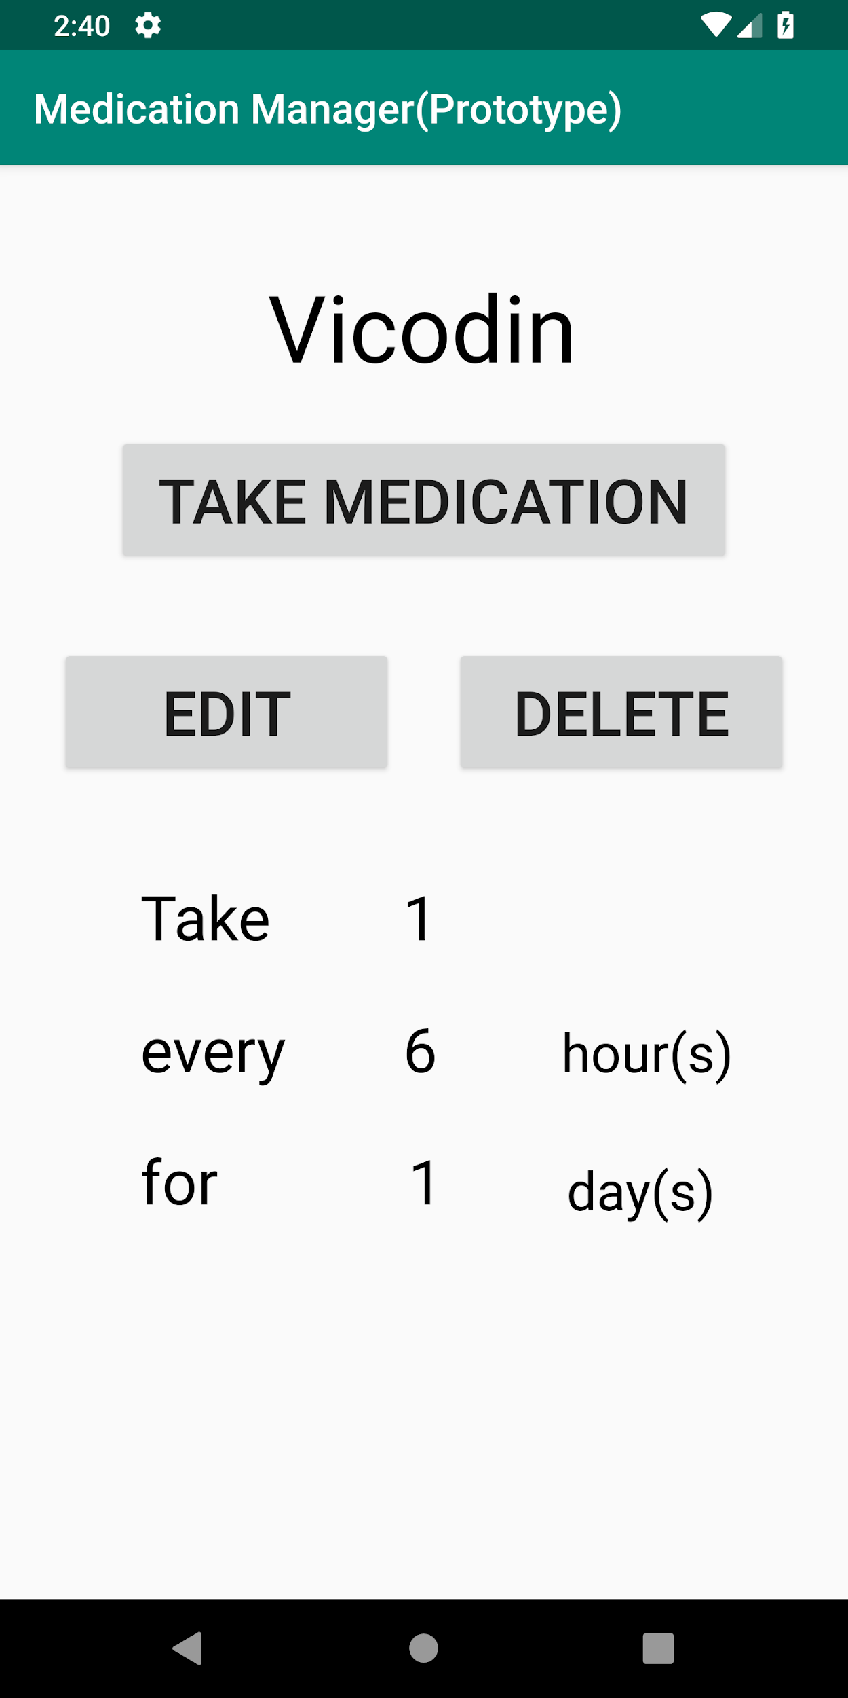
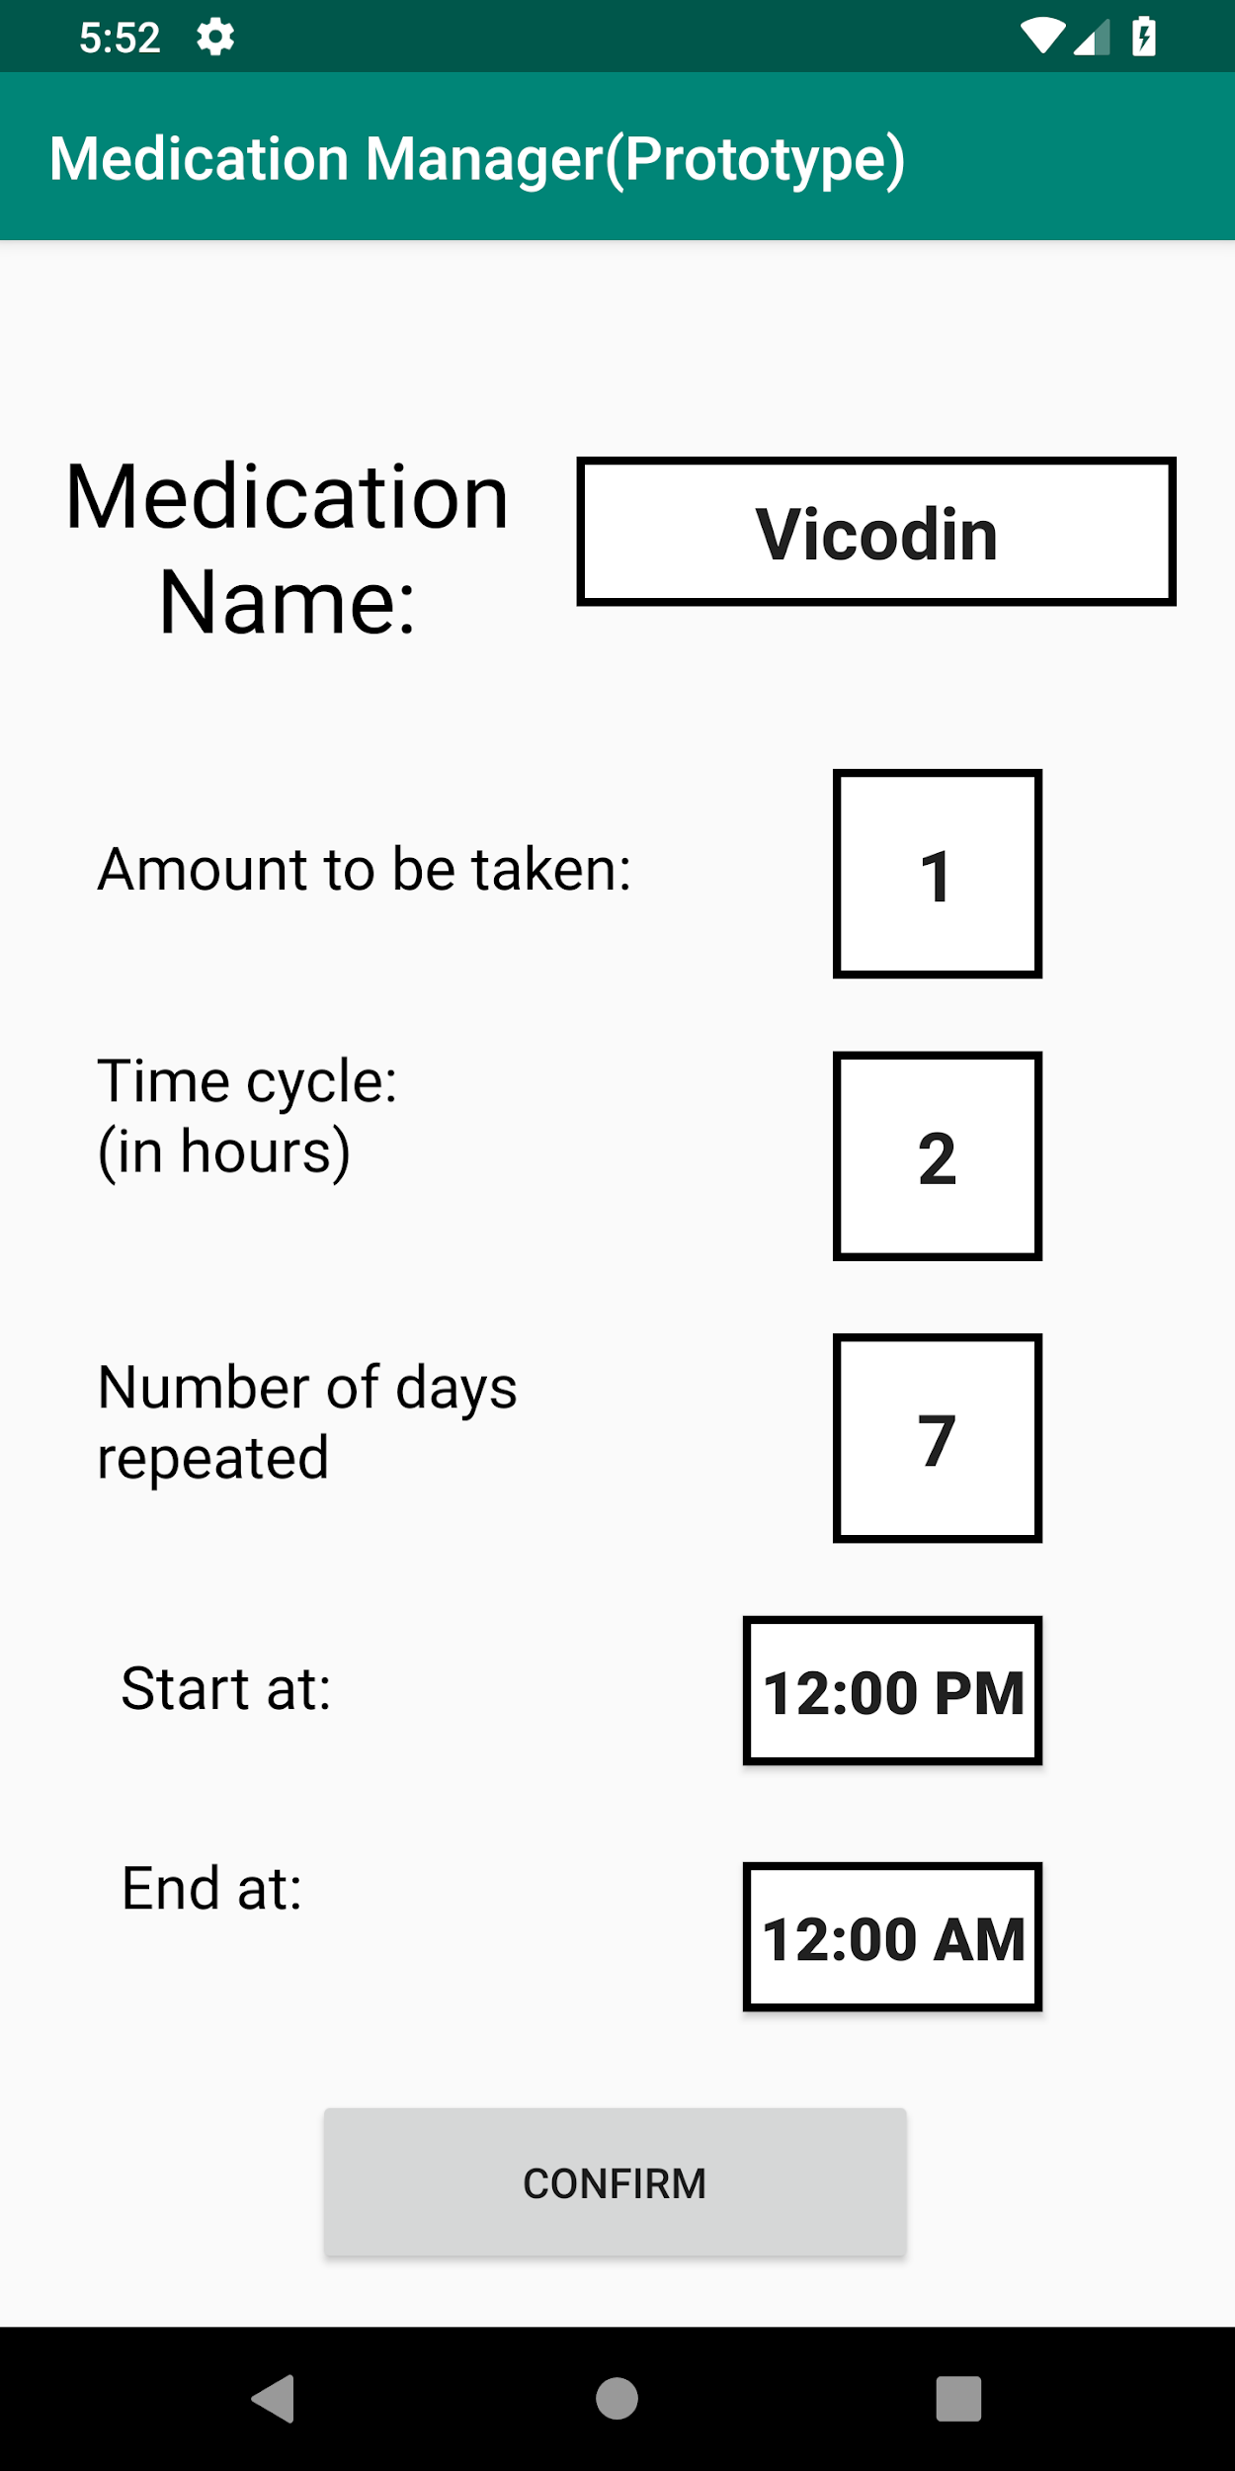
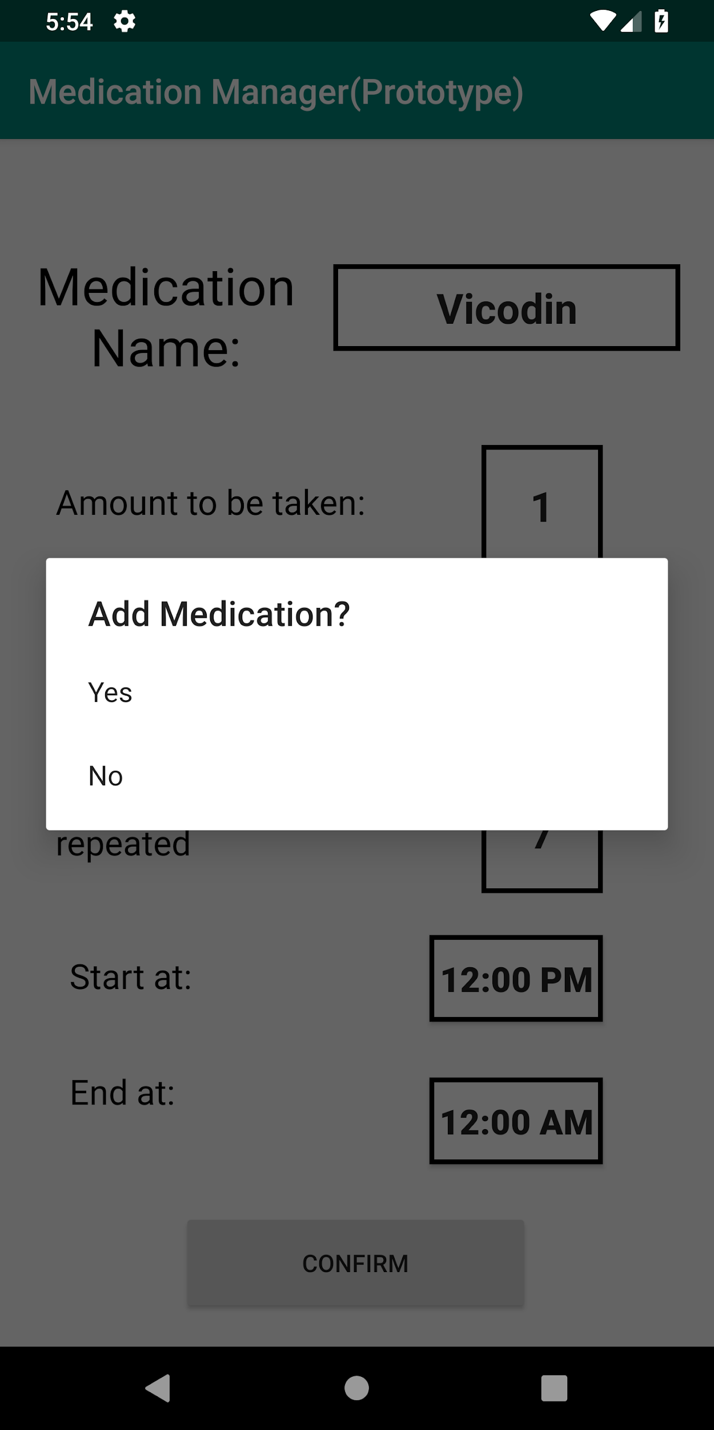
Computer Prototype - First Iteration
Viewing a Current Medication
Editing a Medication
List of Current Medications
Selected Medication
Screen
Edit Medication Page. Values are prefilled for the user.
Confirmation popup for confirming an edit.

Slide 7
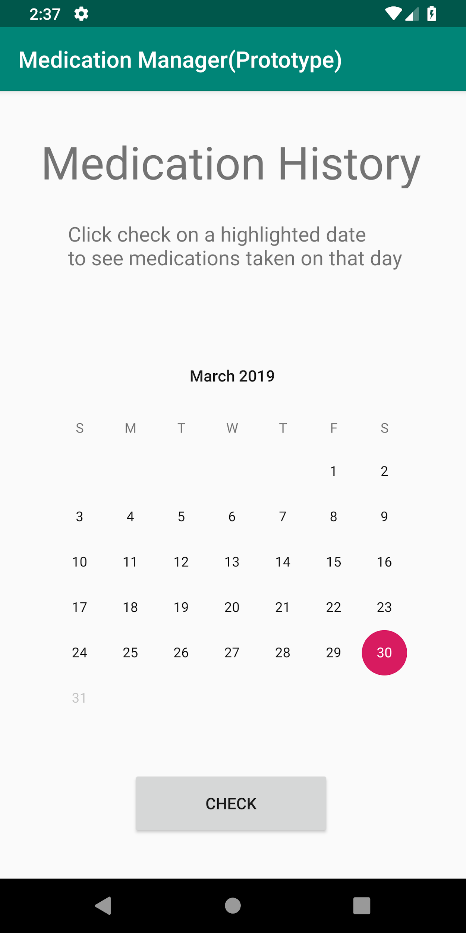
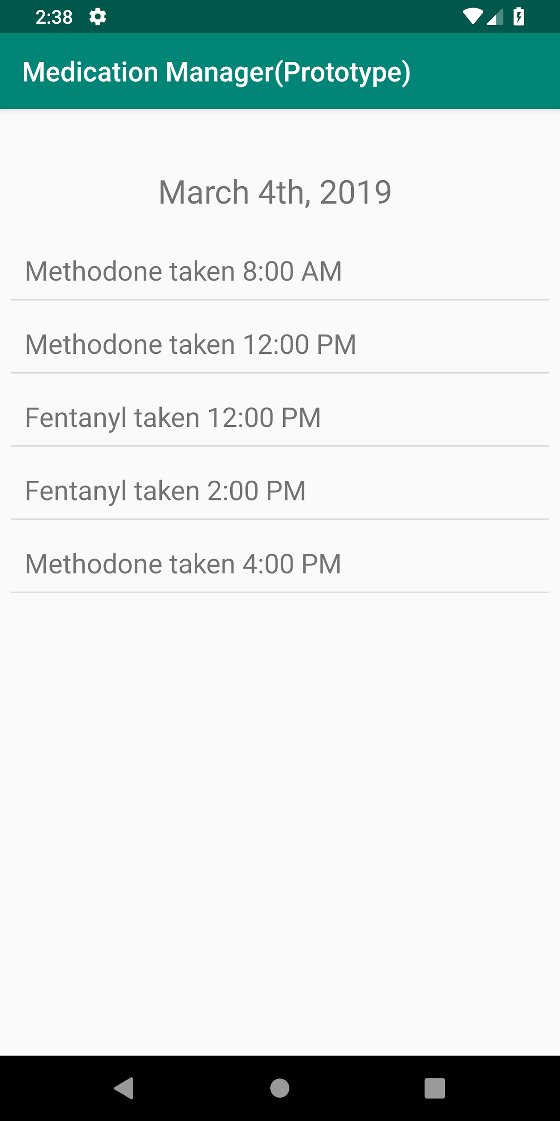
Computer Prototype - First Iteration
Checking Medication History
Date Selection Calendar
List Displaying
Medications Taken on Chosen Date

Slide 8
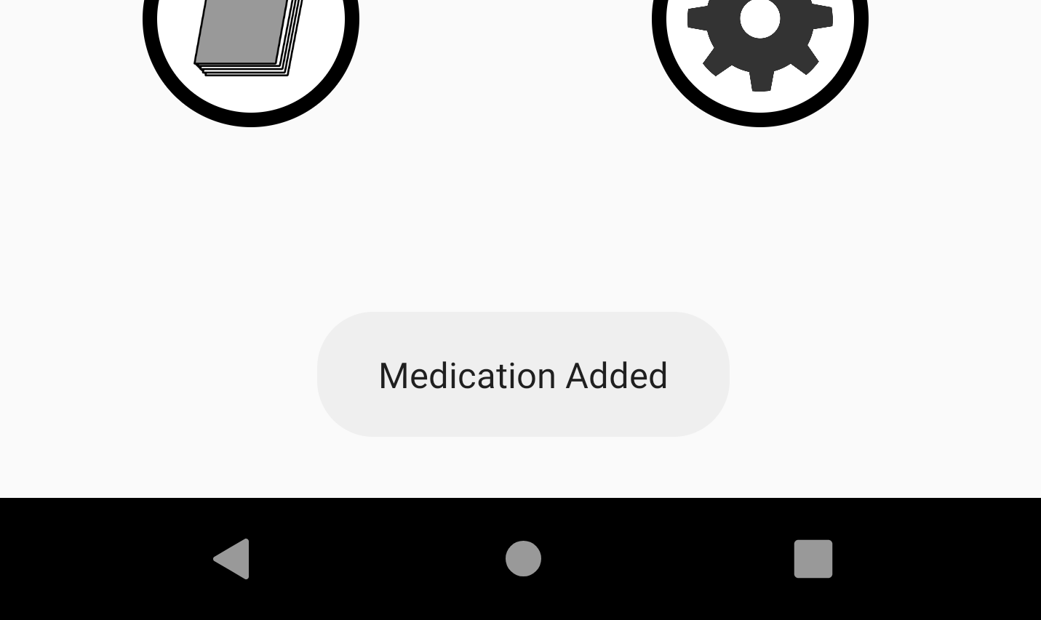
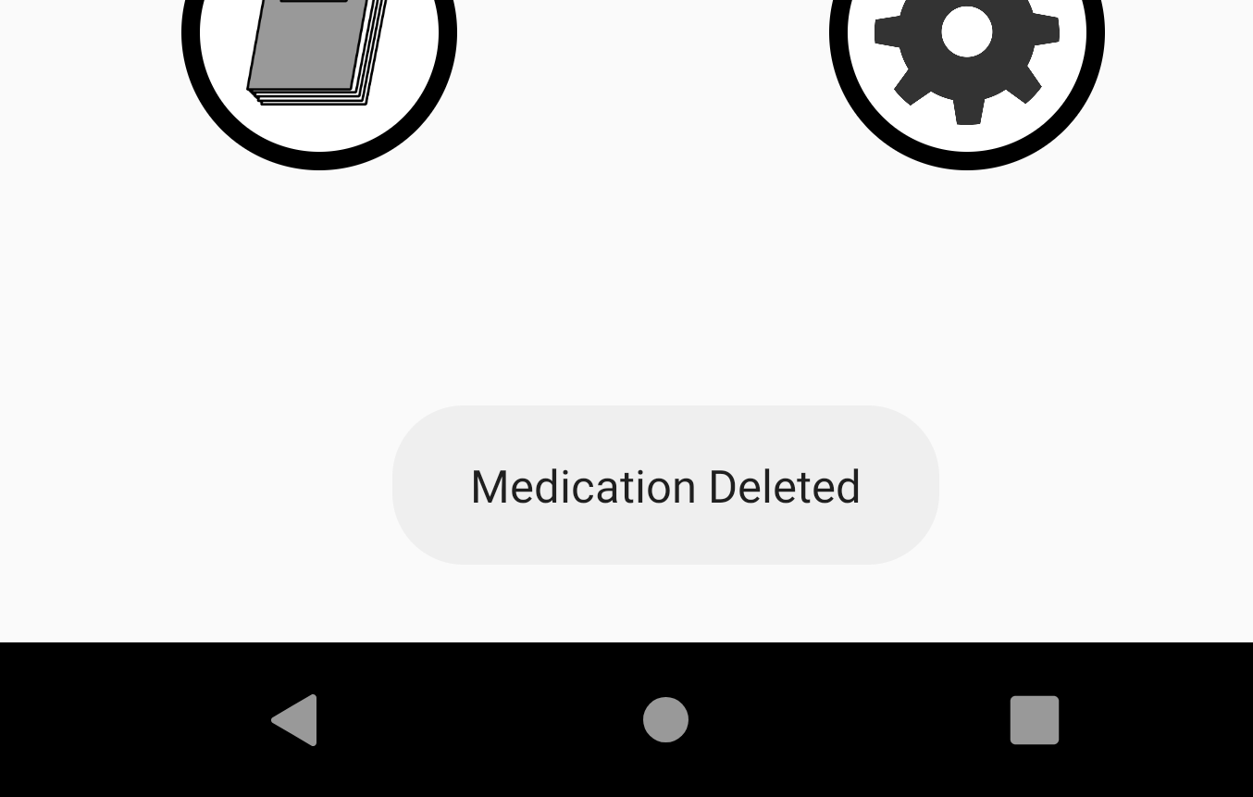

Computer Prototype - First Iteration
Feedback Messages
Displayed after Adding a New Medication
Displayed after Deleting an Existing Medication
Displayed after Clicking on Take Medication Button

Slide 9
Heuristic Evaluations
Our first iteration did not have a readily available option to return to the Home Menu at any given time. If a user wanted to return home while in the middle of a task, they had to repeatedly click on the back button until they returned to the home page. As a result, user control and freedom was restricted and made the users frustrated at certain points.
After completing tasks, our users appreciated the error prevention from the confirmation popups for adding and deleting medications. However, they felt that taking a medication should have its own confirmation as well.

Slide 10
Heuristic Evaluations
A form of error prevention not included in the first iteration was ensuring all fields were filled in before confirming a new or edited medication.
A consistent issue among users was not knowing the system status while on certain parts of the interface. For example, it was difficult for a user to determine if they were adding a medication, or editing an existing one because those two parts of the interface are identical.
The feedback messages given after completing certain actions helped our users validate that those actions were actually completed, helping them move on to the next task without further delay.

Slide 11
Heuristic Evaluations
Filling in the values for Amount Taken, Time Cycle, and Days Repeated allowed any type of character, where as it should have only allow numbers to be input. By not restricting input, there was potential for users to input bad values, which would not make sense when those values were displayed in the future.
A frequent occurrence with the interface was having it return to the home menu after completing actions. In most cases, there was a more appropriate part of the interface to display instead. As a result, efficiency was not as high as it could be.

Slide 12
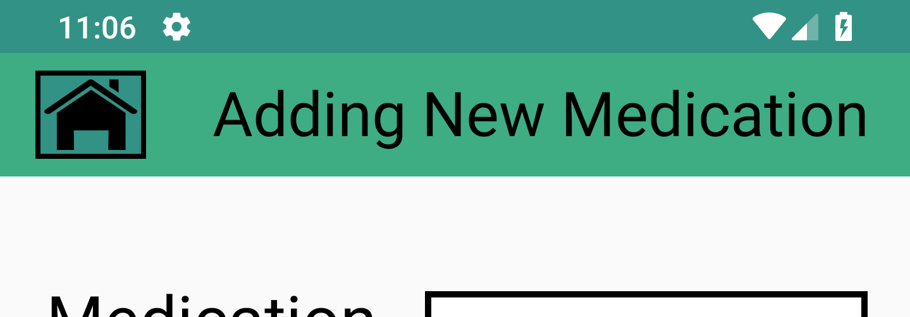
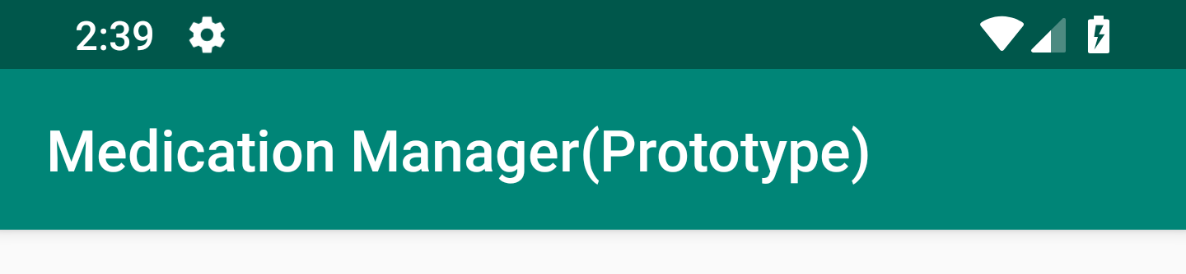
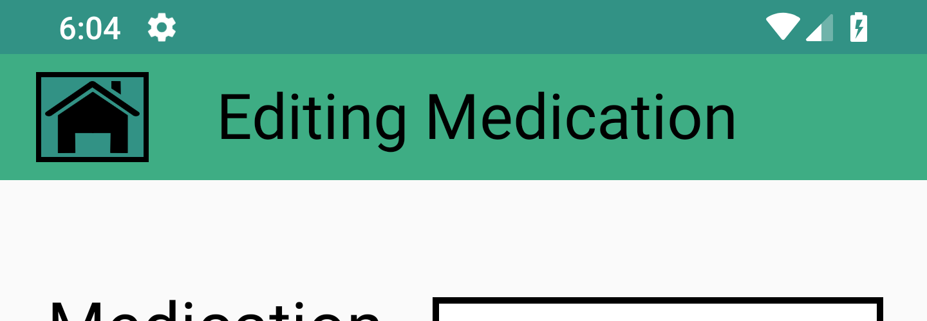
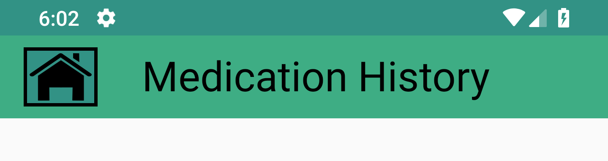
Second Iteration of Computer Prototype
To address the issue of no return to home option on any of the applications pages, we modified the toolbar at the top of the application to be more functional. This toolbar now contains the home button on the left side, and additionally, contains a title displaying the system status.
Iteration 1. Static toolbar that was shared for all parts of the application.
Iteration 2. Toolbars with home button and relevant title.

Slide 13
Second Iteration of Computer Prototype
From the first iteration to the second iteration, it was important to address proper redirection from different parts of the interface to each other. Initially, most completion of most tasks would redirect you to the home menu.
Redirection Changes Implemented for Iteration 2
After adding a new medication, the user is directly taken to the list of current medications
Confirming a medication was taken takes the user back to the current medication list
Deleting a medication takes you back to the list of current medications. If the user deleted the last medication in the list, they are sent to the home menu instead.
Clicking confirm for editing a medication takes you back to the edited medication’s page.

Slide 14
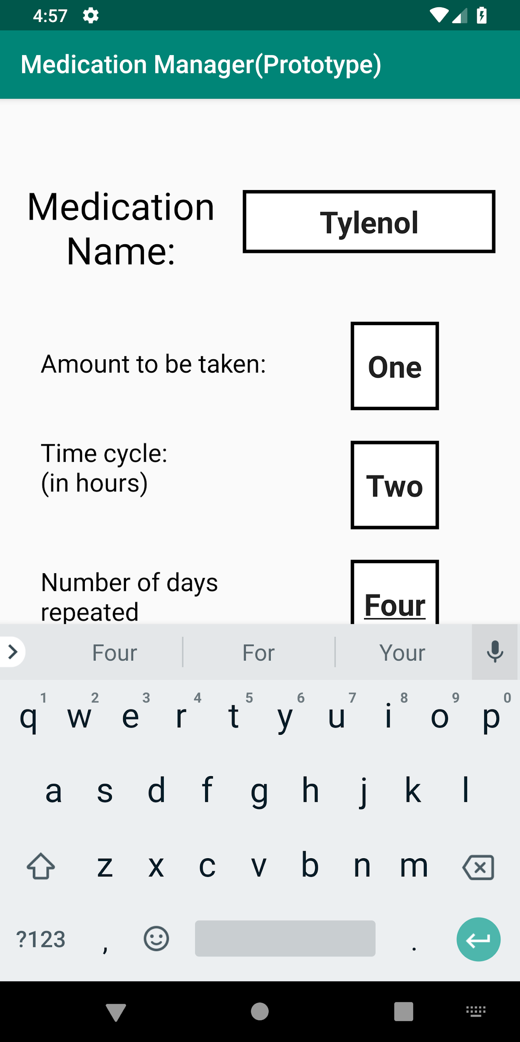
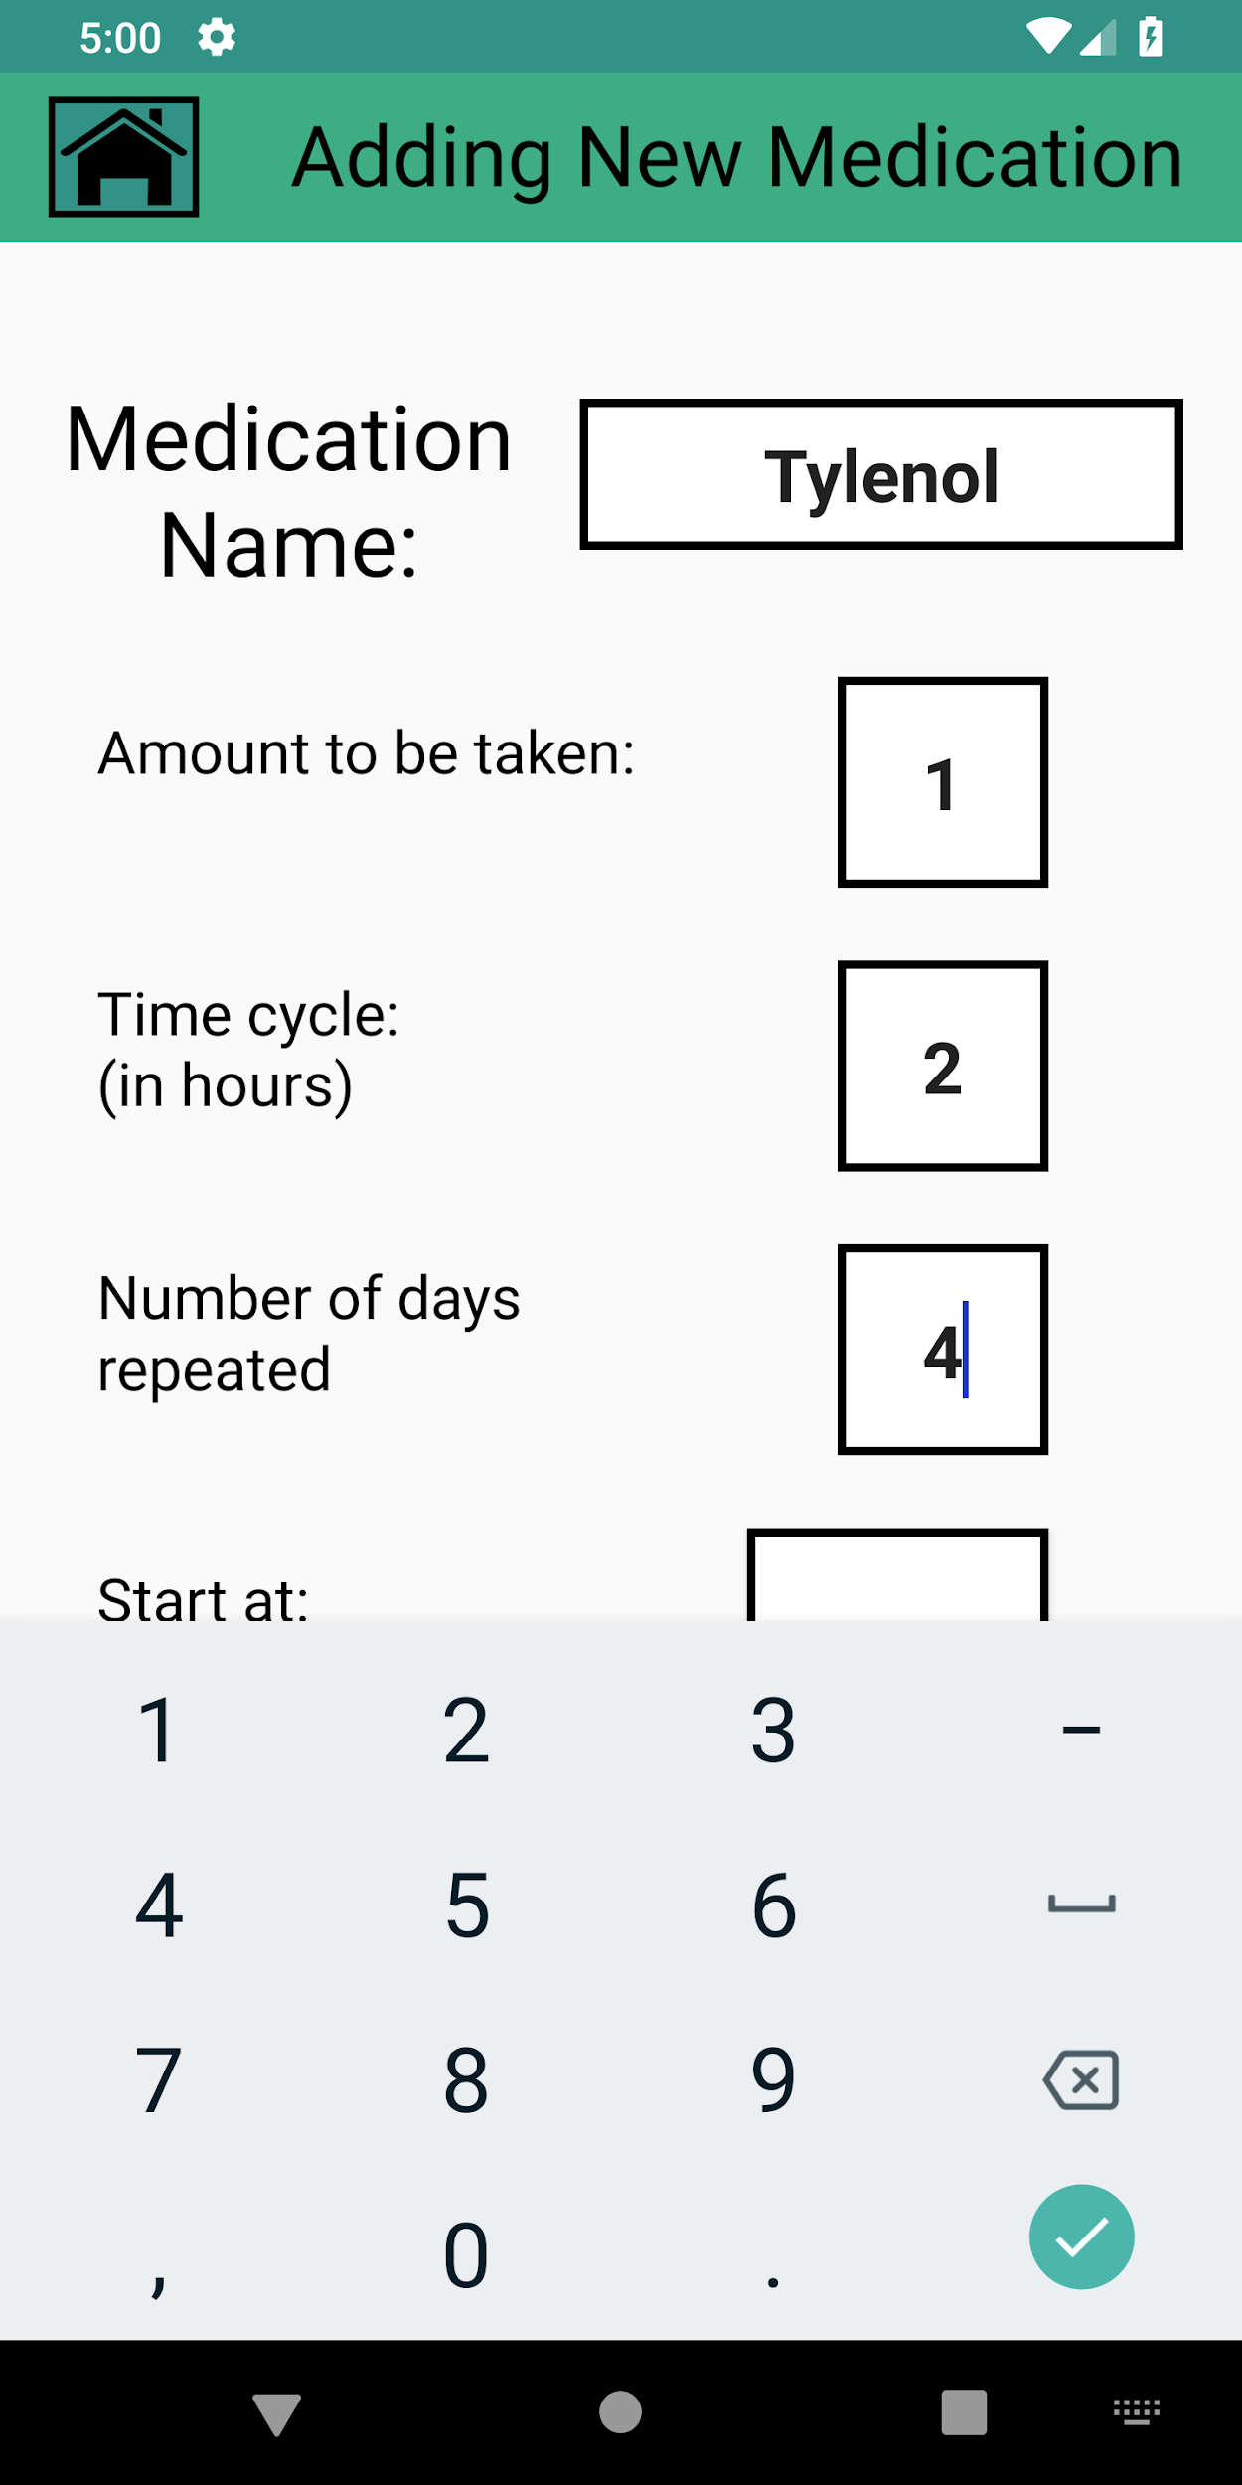
Second Iteration of Computer Prototype
The issue of inputting non-numeric values where only numeric values were allowed was fixed by changing the settings of the soft keyboard to a number pad when the corresponding input fields were selected.
Iteration 1.
Iteration 2.

Slide 15
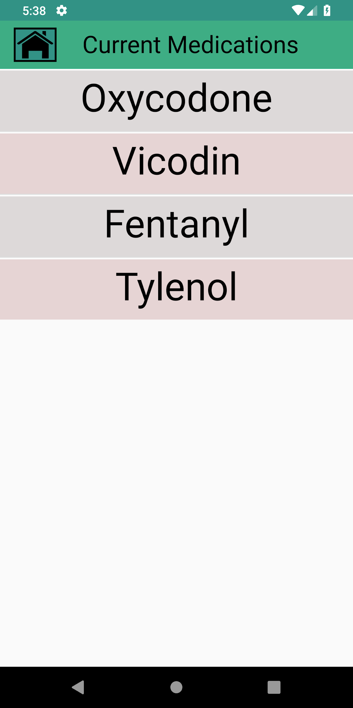
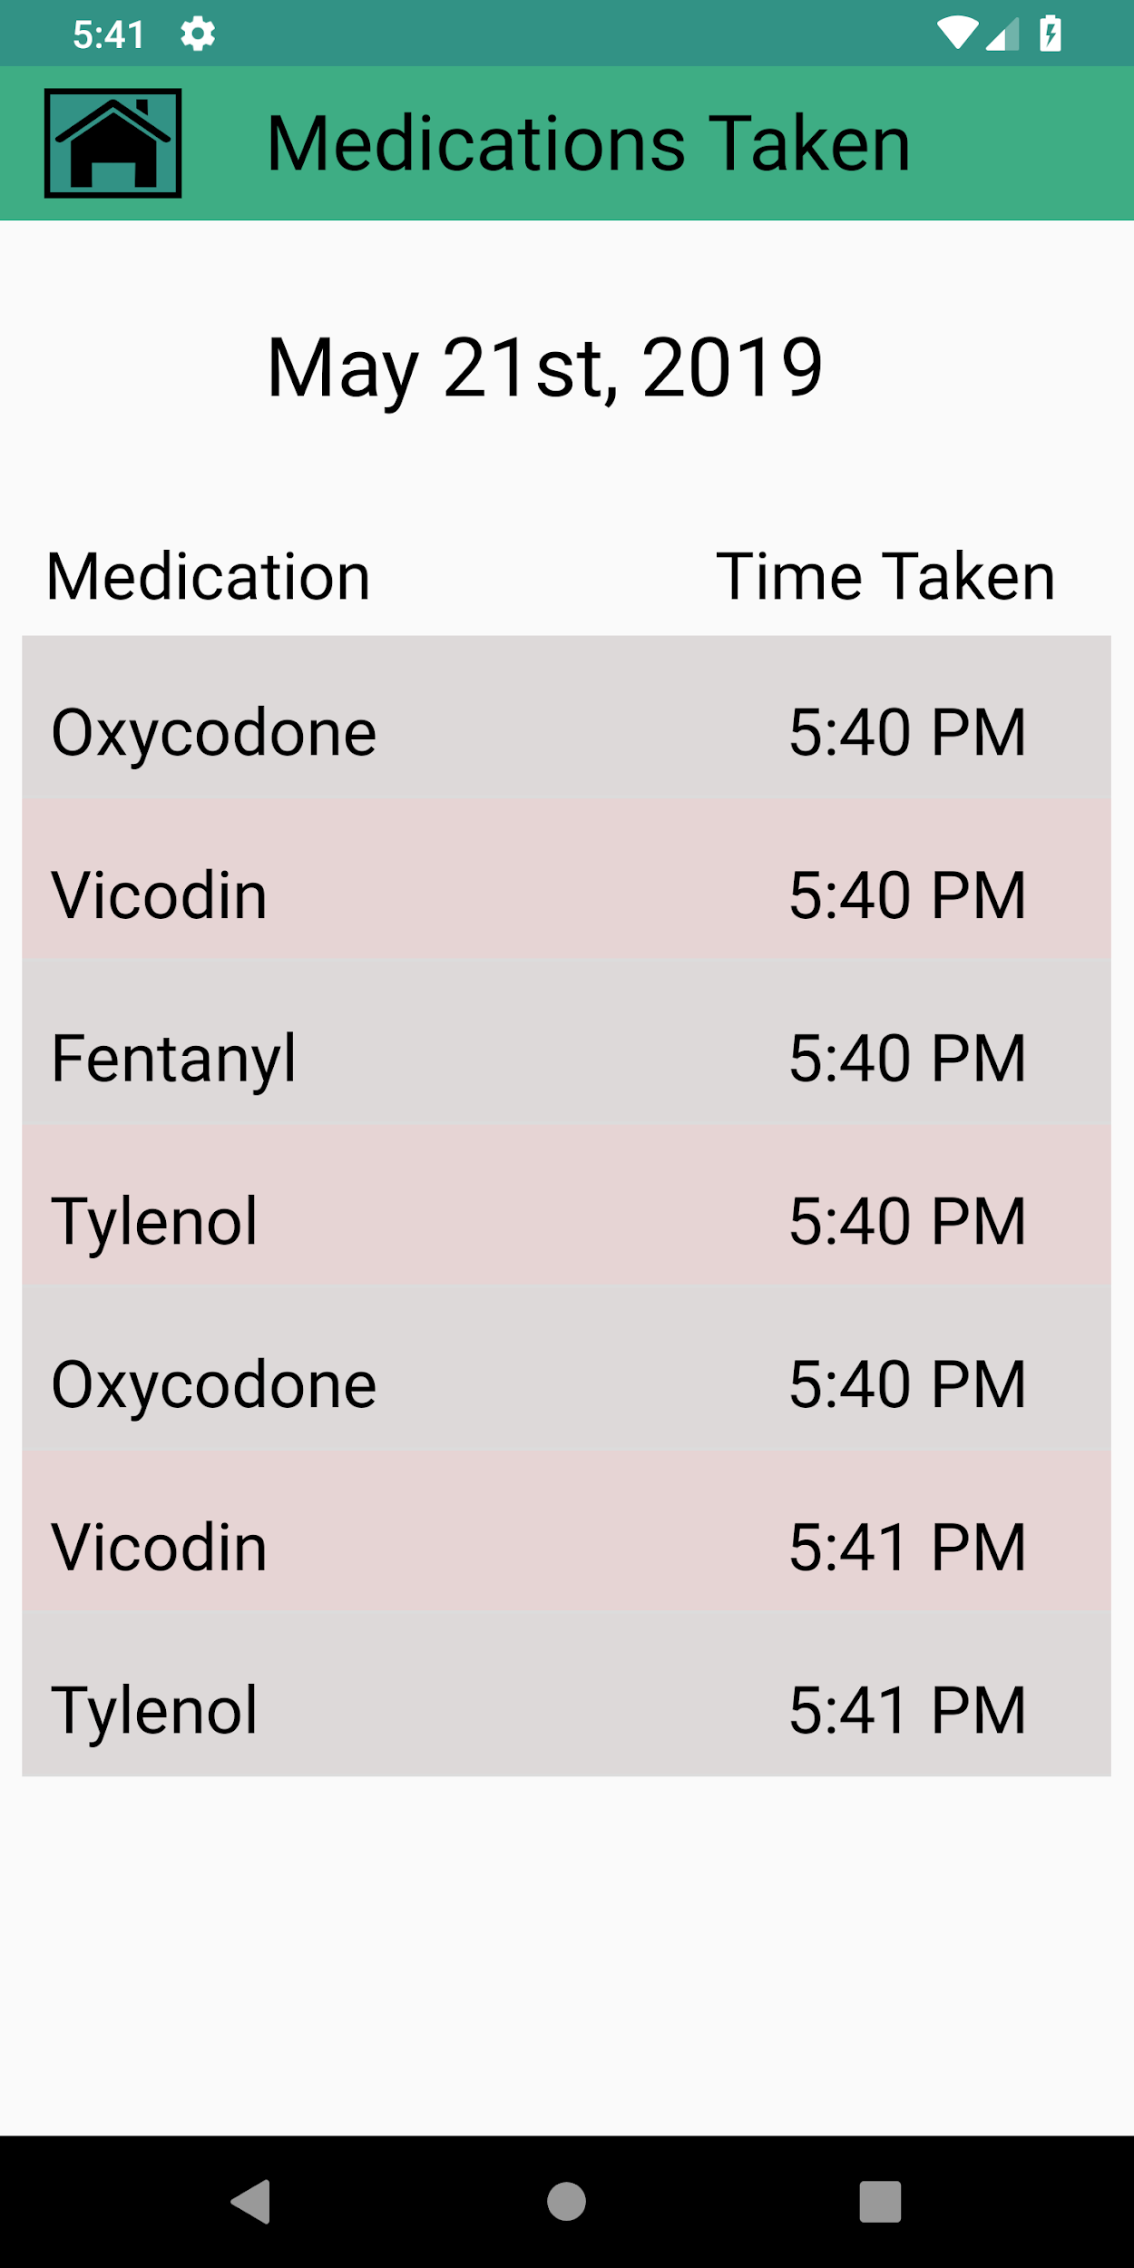
Second Iteration of Computer Prototype
As a cosmetic change, we added a coloring scheme to the medication list, and the taken medications list with different colors for the even and odd items in the lists.

Slide 16
Aspects of Usability
Image Buttons (Learnability): The buttons on the main menu contain images corresponding to what actions they perform.
Time Picker Dialog (Learnability): The clock that users use to set start and end times resembles a real world metaphor of an analog clock where the hour and minutes need to be set.
Editing a Medication (Learnability) : The user gets directed to the part of the interface which is similar to the add medication page, with all of the input fields pre filled with the current parameters of the medication, to ensure consistency.

Slide 17
Aspects of Usability
Confirmation Popups (Safety): Adding, editing, deleting, or taking a medication as well as clicking on the home button all prompt the user if they want to go through with that action in an effort to reduce errors.
Input Checking and Restriction (Safety): The pages where the user adds or edits a medication makes ensures valid inputs and that all input fields are filled in before the user can proceed.
Home Button (Efficiency): The home button present on all pages except the home page, will send the user back to the home menu should they feel stuck, or just need to get back to the home page.

Slide 18
Aspects of Usability
Action Feedback (Learnability): After completing various actions with medications, a message is given at the bottom of the application informing that the action was completed.
Date Picker (Learnability): The element which allows the user uses to select the date uses the real life metaphor of a calendar.

Slide 19
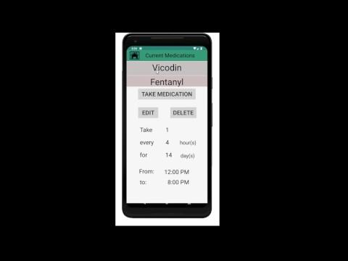
Video Demo

Slide 20
Questions?

